Slide 1
Chapter 22: Enterprise Network Architecture
Instructor Materials
CCNP Enterprise: Core Networking

Slide 2
Chapter 22 Content
This chapter covers the following content:
Hierarchical LAN Design Model - This section describes the hierarchical network design, which improves performance, simplifies design, increases scalability, and reduces troubleshooting time.
Enterprise Network Architecture Options - This section describes the different options available for deploying an enterprise campus architecture based on the hierarchical LAN design model.

Slide 3
Hierarchical LAN Design Model
A hierarchical LAN design model divides the enterprise network architecture into modular layers.
Modular layers allow each layer to implement specific functions.
Modular layers can be replicated throughout the network providing scaling and a consistent deployment method.
Provides fault containment.
Provides the ability to put network components in place or take them out of service with no impact on the rest of the network.

Slide 4
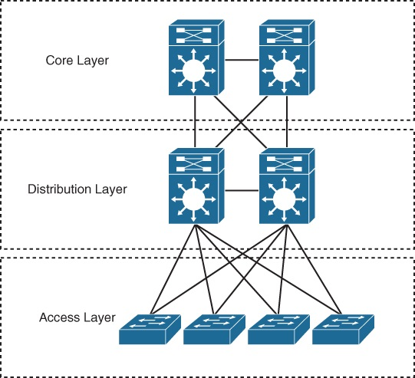
Hierarchical LAN Design Model 3 Layer Design
Access layer - Gives endpoints and users direct access to the network.
Distribution layer - Provides an aggregation point for the access layer and acts as a services and control boundary between the access layer and the core layer.
Core layer (also referred to as the backbone) - Provides connections between distribution layers for large environments.
Figure 22-1 Hierarchical LAN Design

Slide 5
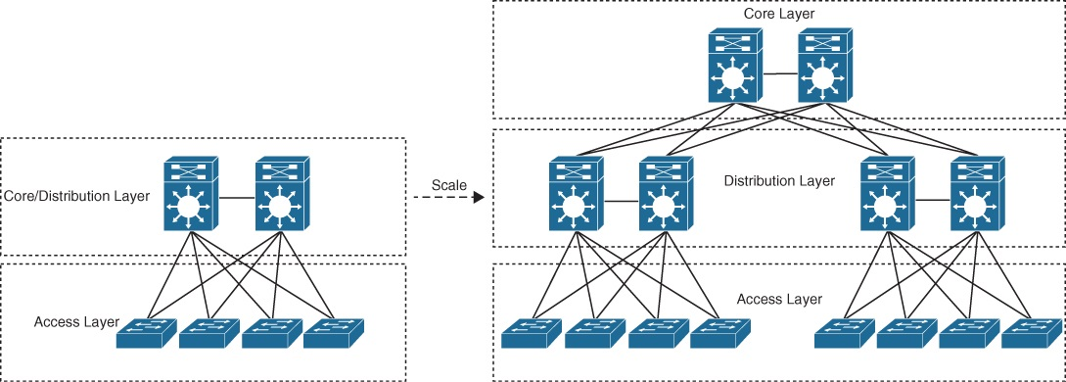
Hierarchical LAN Design Model Scalable Layer Design
The number of layers needed depends on the characteristics of the network deployment site. As illustrated in Figure 22-2, a small campus in a single building might require only access and distribution layers, while a campus that spans multiple buildings will most likely require all three layers. The modularity of this design ensures that each layer will provide the same services and the same design methods.
Figure 22-2 Modular Design Scalability

Slide 6
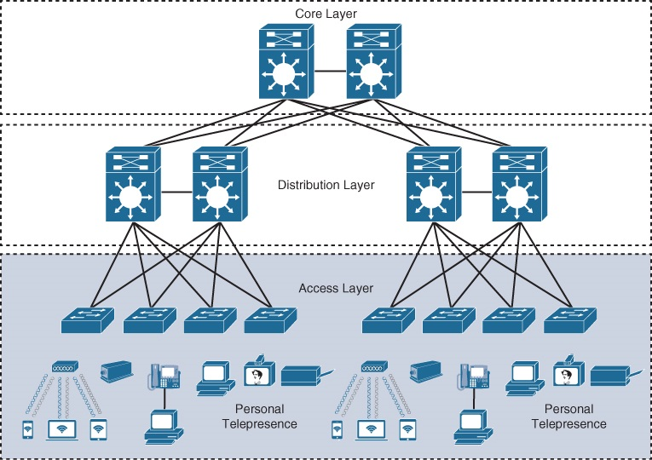
Hierarchical LAN Design Model Access Layer
The access layer, also commonly referred as the network edge, is where end-user devices or endpoints connect to the network.
It provides high-bandwidth device connectivity using wired and wireless access technologies such as Gigabit Ethernet and 802.11n and 802.11ac wireless.
Figure 22-3 Access Layer Connectivity

Slide 7
Hierarchical LAN Design Model Access Layer (Cont.)
It can be segmented (for example, by using VLANs) so that different devices can be placed into different logical networks for performance, management, and security reasons.
In the hierarchical LAN design, the access layer switches are not interconnected to each other. Communication between endpoints on different access layer switches occurs through the distribution layer.
It plays a big role in ensuring that the network is protected from malicious attacks. This protection includes making sure the end users and endpoints connecting to the network are prevented from accessing services for which they are not authorized.
Quality of service (QoS) trust boundary and QoS mechanisms are typically enabled on this layer to ensure that QoS is provided end-to-end to satisfy the end user’s quality of experience (QoE).

Slide 8
Hierarchical LAN Design Model Distribution Layer
The primary function of the distribution layer is to aggregate access layer switches in a given building or campus.
The distribution layer provides a boundary between the Layer 2 domain of the access layer and the core’s Layer 3 domain.
This boundary provides two key functions for the LAN:
On the Layer 2 side, the distribution layer creates a boundary for Spanning Tree Protocol (STP), limiting propagation of Layer 2 faults.
On the Layer 3 side, the distribution layer provides a logical point to summarize IP routing information when it enters the core of the network. The summarization reduces IP routing tables for easier troubleshooting and reduces protocol overhead for faster recovery from failures.

Slide 9
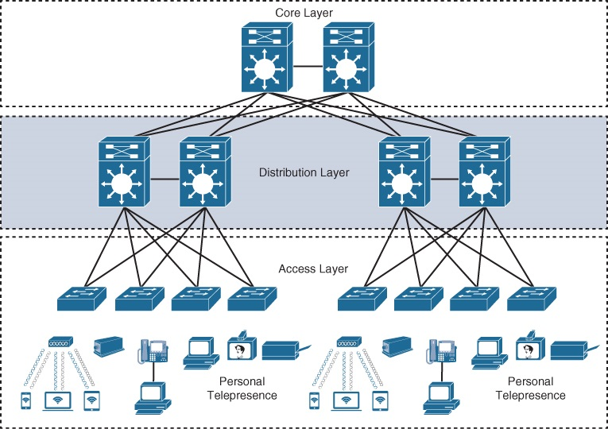
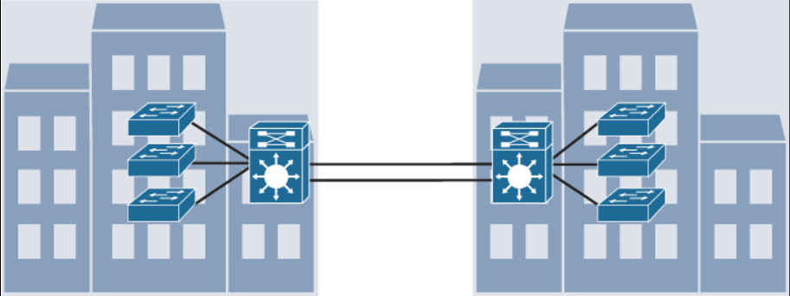
Hierarchical LAN Design Model Distribution Layer
The distribution switches need to be deployed in pairs for redundancy as displayed in Figure 22-4.
The distribution layer switch pairs should be interconnected to each other using either a Layer 2 or Layer 3 link.
When campus buildings are geographically dispersed, distribution layer switches can be located within the buildings in order to reduce the number of fiber-optic runs (which are costly) between buildings.
Figure 22-4 Distribution Layer Connectivity
Figure 22-5 Distribution Layer Reducing Fiber Optic Runs

Slide 10
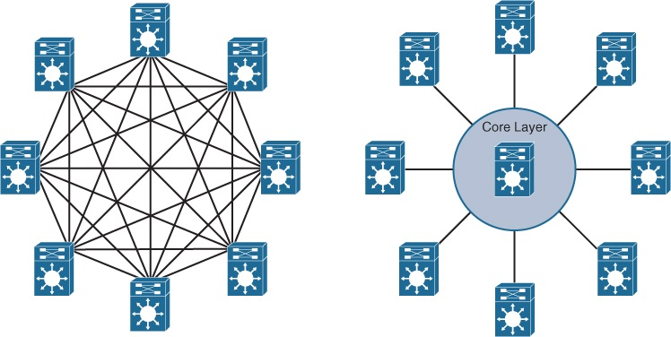
Hierarchical LAN Design Model Core Layer
As networks grow beyond three distribution layers in a single location, organizations should consider using a core layer to optimize the design.
The core layer is the backbone and aggregation point for multiple networks and provides scalability, high availability, and fast convergence to the network.
The core can provide high-speed connectivity for large enterprises with multiple campus networks distributed worldwide, and it can also provide interconnectivity between the end-user/endpoint campus access layer and other network blocks, such as the data center, the private cloud, the public cloud, the WAN, the internet edge, and network services.
Figure 22-6 Core Layer Reduces Large Network Complexity
Use of the core to reduce the network complexity, from N × (N − 1) to N links for N distribution layer switches.

Slide 11
Enterprise Network Architecture Options
Two-tier design (collapsed core)
Three-tier design
Layer 2 access layer (STP based)
Layer 3 access layer (routed access)
Simplified campus design
Software-Defined Access (SD-Access)

Slide 12
Enterprise Network Architecture Options Two-tier design (Collapsed Core)
Smaller campus networks may have multiple departments spread across multiple floors within a building. In these environments, a core layer may not be needed, and collapsing the core function into the distribution layer can be a cost-effective solution (as no core layer means no core layer devices) that requires no sacrifice of most of the benefits of the three-tier hierarchical model.
Prior to selecting a two-tier collapsed core and distribution layers, future scale, expansion, and manageability factors need to be considered.

Slide 13
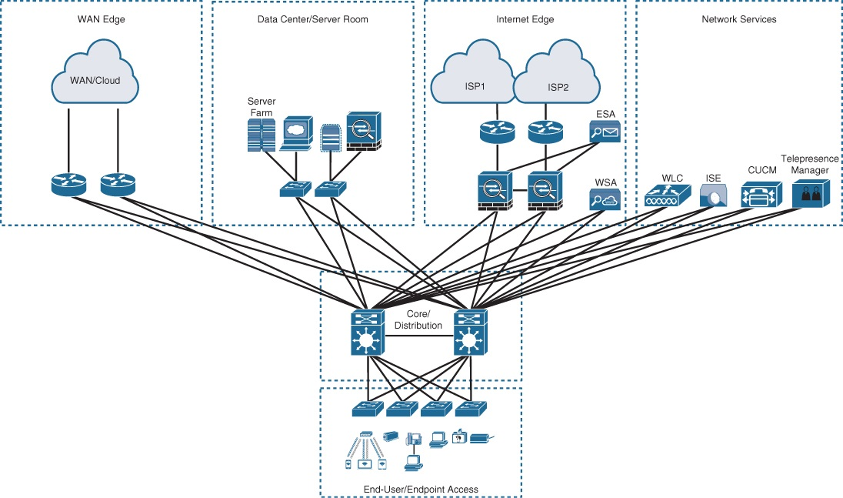
Enterprise Network Architecture Options Two-tier design (Cont.)
Switches at the Core/Distribution layer provide two separate functions:
connectivity to the WAN, Data Center, internet, and network services edge blocks
LAN aggregation to the end-user access layer switches
The WAN Edge block connects to remote data centers, remote branches, or other campus networks or for connectivity to cloud providers.
The Data Center/Server Room block is where business-critical servers are placed.
The Internet Edge block is used for regular internet access, e-commerce, connection to remote branches, remote VPN access and non-dedicated cloud provider connections.
The Network Services block is where devices providing network services reside, such as wireless LAN controllers (WLCs).
Figure 22-7 Two-Tier/Collapsed Core Design

Slide 14
Enterprise Network Architecture Options Three-Tier Design
Three-tier designs separate the core and distribution layers and are recommended when more than two pairs of distribution switches are required.
Multiple pairs of distribution switches are typically required for the following reasons:
When implementing a network for a large enterprise campus composed of multiple buildings, where each building requires a dedicated distribution layer.
When the density of WAN routers, internet edge devices, data center servers, and network services are growing to the point where they can affect network performance and throughput.
When geographic dispersion of the LAN access switches across many buildings in a larger campus facility would require more fiber-optic interconnects back to a single collapsed core.

Slide 15
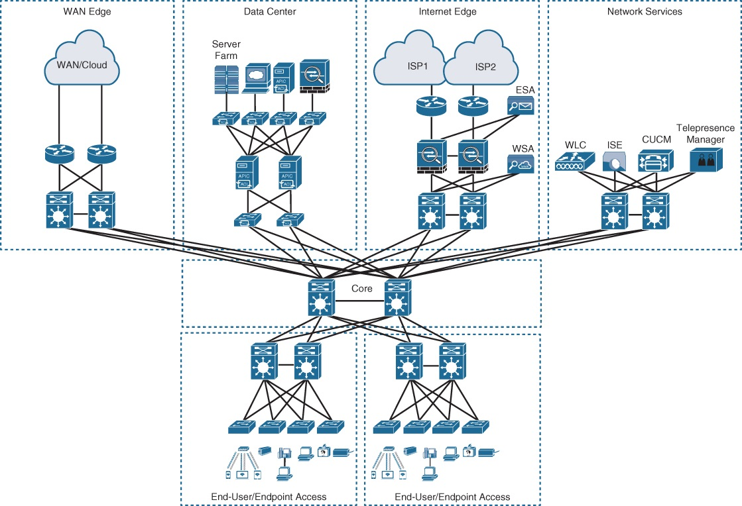
Enterprise Network Architecture Options Three-Tier Design (Cont.)
In Figure 22-8, the building blocks or places in the network (PINs) are each using the hierarchical design model.
Each block is deployed with a pair of distribution switches connected to the core.
The hierarchical LAN design is more appropriate for north–south traffic flows, such as endpoints communicating with the WAN edge, data center, Internet, or network services blocks.
The data center block is using the newer leaf–spine design, an alternative to the three-tier design when traffic is predominantly east–west between servers within the data center.
Figure 22-8 Three-Tier Design

Slide 16
Enterprise Network Architecture Options Layer 2 Access Layer (STP Based)
Traditional LAN designs use a Layer 2 access layer and a Layer 3 distribution layer.
The distribution layer is the Layer 3 IP gateway for access layer hosts.
Whenever possible, it is recommended to restrict a VLAN to a single access layer switch to eliminate topology loops.
Restricting a VLAN to a single switch provides a loop-free design, but at the cost of network flexibility because all hosts within a VLAN are restricted to a single access switch.
Some organizations require that the same Layer 2 VLAN be extended to multiple access layer switches to accommodate an application or a service.
The looped design causes STP to block links, which reduces the bandwidth from the rest of the network and can cause slower network convergence.

Slide 17
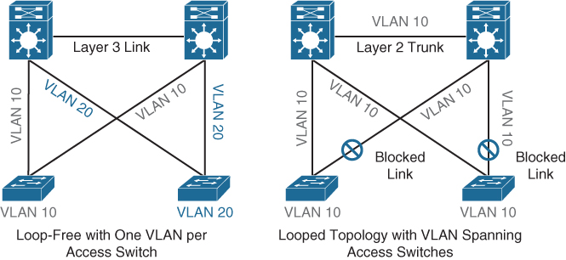
Enterprise Network Architecture Options Layer 2 Access Layer (STP Based) – Topology Design
Figure 22-9 illustrates a loop-free topology where a VLAN is constrained to a single switch, as well as a looped topology where a VLAN spans multiple access switches. The looped design causes STP to block links.
Figure 22-9 Loop-Free Topology and Looped Topology

Slide 18
Enterprise Network Architecture Options Layer 2 Access Layer (STP Based) – High Availability
First-hop redundancy protocols (FHRPs) provide hosts with a consistent MAC address and gateway IP address for each configured VLAN. The distribution layer should have a pair of standalone switches configured with a FHRP.
Hot Standby Router Protocol (HSRP) and Virtual Router Redundancy Protocol (VRRP) are the most common first-hop redundancy protocols.
The downside to these protocols is that they only allow hosts to send data out the active FHRP router through a single access uplink.
This leaves one of the access layer-to-distribution layer uplinks unutilized unless manual configuration of the distribution layer is performed.
Gateway Load Balancing Protocol (GLBP) provides greater uplink utilization for access layer-to-distribution layer traffic by load balancing the load from hosts across multiple uplinks.
The downside is that it works only on loop-free topologies.

Slide 19
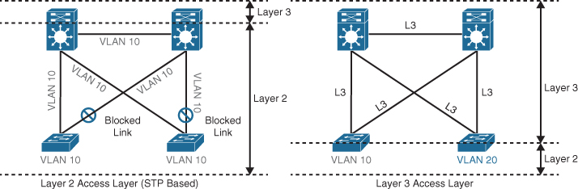
Enterprise Network Architecture Options Layer 3 Access Layer (Routed Access)
Routed access is an alternative configuration in which Layer 3 is extended all the way to the access layer switches. In this design, access layer switches act as full Layer 3 routed nodes (providing both Layer 2 and Layer 3 switching), and the access-to-distribution Layer 2 uplink trunks are replaced with Layer 3 point-to-point routed links. Consequently, the Layer 2/Layer 3 demarcation point is moved from the distribution switch to the access switch, as illustrated in Figure 22-10.
Figure 22-10 Layer 2 Access Layer and Layer 3 Access Layer

Slide 20
Enterprise Network Architecture Options Layer 3 Access Layer (Routed Access)
The routed access-to-distribution block design advantages over the Layer 2 access layer design:
No first-hop redundancy protocol required - It eliminates the need for first-hop redundancy protocols such as HSRP and VRRP.
No STP required - Because there are no Layer 2 links to block, this design eliminates the need for STP.
Increased uplink utilization - Both uplinks from access to distribution can be used, increasing the effective bandwidth available to the end users and endpoints connected to the access layer switches.
Easier troubleshooting - It offers common end-to-end troubleshooting tools (such as ping and traceroute).
Faster convergence - It uses fast-converging routing protocols such as Enhanced Interior Gateway Routing Protocol (EIGRP) and Open Shortest Path First (OSPF).

Slide 21
Enterprise Network Architecture Options Simplified Campus Design
Relies on switch clustering such as a virtual switching system (VSS) and stacking technologies such as StackWise, in which multiple physical switches act as a single logical switch. Clustering and stacking technologies can be applied to any of the campus building blocks to simplify them even further. Using this design offers the following advantages:
Simplified design - By using the single logical distribution layer design, there are fewer boxes to manage, which reduces the amount of time spent on ongoing provisioning and maintenance.
No first-hop redundancy protocol required - It eliminates the need for first-hop redundancy protocols such as HSRP and VRRP because the default IP gateway is on a single logical interface.
Reduced STP dependence - Because EtherChannel is used, it eliminates the need for STP for a Layer 2 access design. However, STP is still required as a failsafe in case multiple access switches are interconnected.

Slide 22
Enterprise Network Architecture Options Simplified Campus Design (Cont.)
Simplified Campus Design advantages:
Increased uplink utilization - With EtherChannel, all uplinks from access to distribution can be used, increasing the effective bandwidth available to the end users and endpoints connected to the access layer switches.
Easier troubleshooting - The topology of the network from the distribution layer to the access layer is logically a hub-and-spoke topology, which reduces the complexity of the design and troubleshooting.
Faster convergence - With EtherChannel, all links are in forwarding state, and this significantly optimizes the convergence time following a node or link failure event. Provides fast sub-second failover between links in an uplink bundle.
Distributed VLANs - With this design, VLANs can span multiple access switches without the need to block any links.

Slide 23
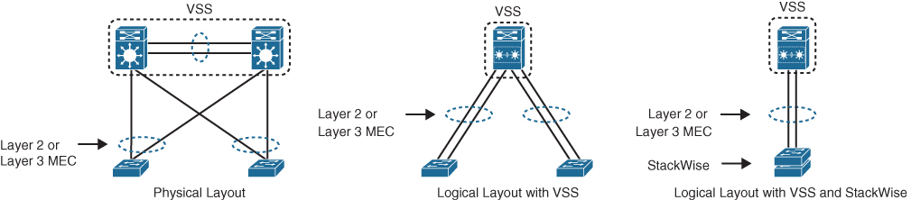
Enterprise Network Architecture Options Simplified Campus Design (Cont.)
The simplified campus design is loop free, highly available, flexible, resilient, and easy to manage. Figure 22-11 illustrates how the network can be simplified by introducing VSS and StackWise into the design.
Figure 22-11 Simplified Campus Design with VSS and StackWise

Slide 24
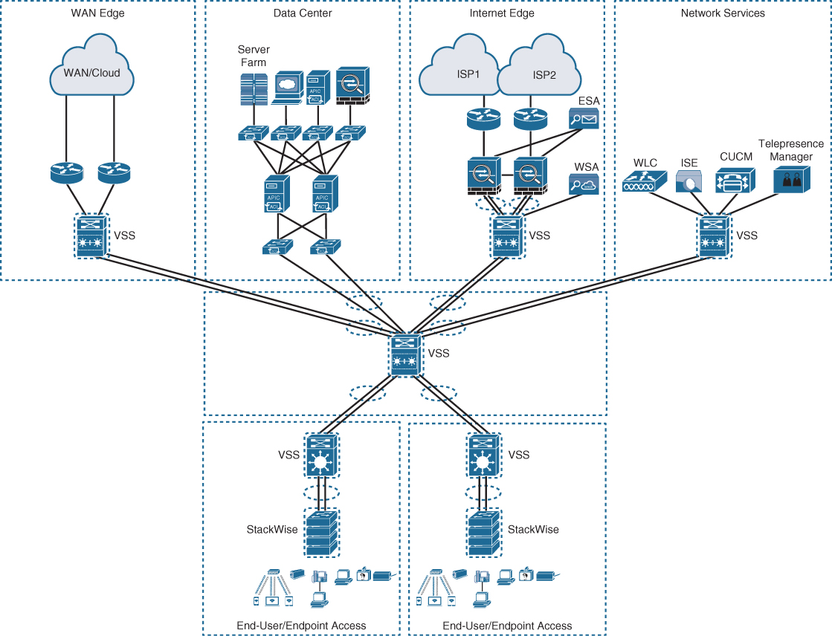
Enterprise Network Architecture Options Simplified Campus Design (Cont.)
Using the simplified campus design approach across all the campus blocks (when possible) can provide an optimized architecture that is easy to manage, resilient, and more flexible, with higher aggregated uplink bandwidth capacity.
Figure 22-12 Applying VSS and StackWise in a Campus Network

Slide 25
Enterprise Network Architecture Options Software-Defined Access (SD-Access) Design
SD-Access - Industry’s first intent-based networking solution for the enterprise
Built on the principles of the Cisco Digital Network Architecture (DNA)
A combination of the campus fabric design and the Digital Network Architecture Center (Cisco DNA or DNAC).
Adds fabric capabilities to the enterprise network through automation
Provides automated end-to-end segmentation to separate user, device, and application traffic without requiring a network redesign
Fabric capabilities provide services such as host mobility and enhanced security in addition to the normal switching and routing capabilities.

Slide 26
Prepare for the Exam

Slide 27
Prepare for the Exam Key Topics for Chapter 22
Description
Hierarchical LAN design model/layers
Access layer
Distribution layer
Core layer
Two-tier design (collapsed core)
Three-tier design
Layer 2 access layer (STP based)
Layer 3 access layer (routed access)
Simplified campus design

Slide 28
Prepare for the Exam Key Terms for Chapter 22
Term
access layer
building block
core layer
distribution layer
network block
place in the network (PIN)

